Slide 1

Indiana Clinical and Translational Sciences Institute
2023 Annual Meeting
A Proteomics Based Approach for Material Selection in a Model of the Pre-Metastatic Niche
Madison Howard, Evelyn Nonamaker, Luis Solorio
PhD Student, Biomedical Engineering, Purdue University

Slide 2
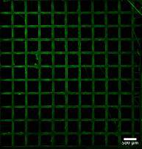
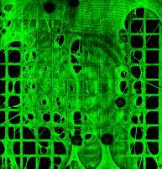

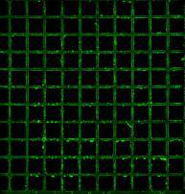
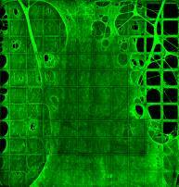
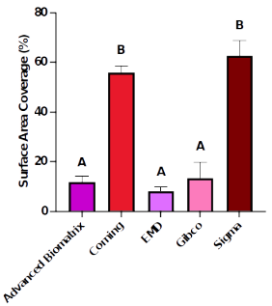

Fibril Formation Differs Between Commercial Fibronectin Products
Advanced Biomatrix
Corning
EMD
Gibco
Sigma
Corning and Sigma had the highest fibronectin coverage compared to the other brands

Slide 3
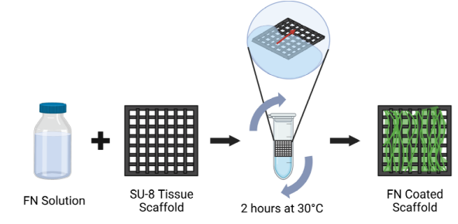
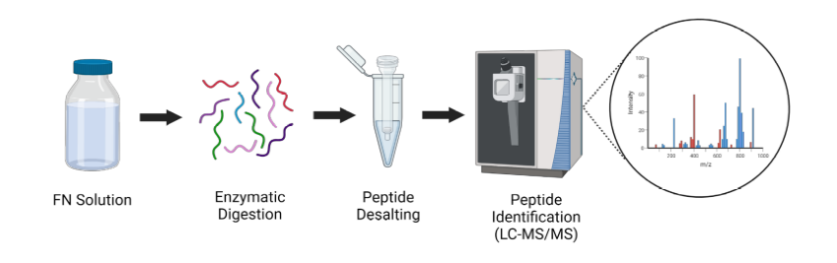
Methodology
Fibronectin Scaffold Coating Process:
Proteomic Digestion Process:

Slide 4
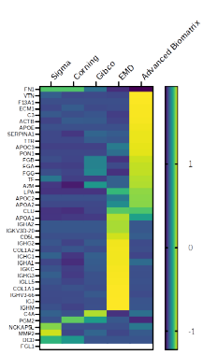
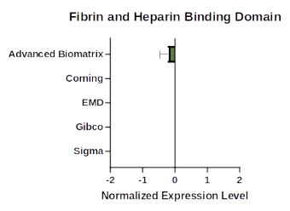
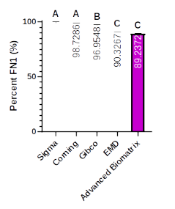
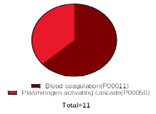
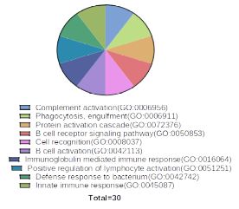
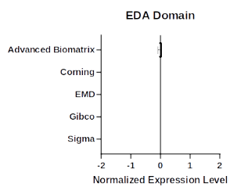
Protein and Peptide Composition Differs Between Commercial Brands of Fibronectin
Advanced Biomatrix GO
EMD GO
Sigma and Corning have highest FN1 percentage and upregulated domains responsible for fibrillogenesis

Slide 5
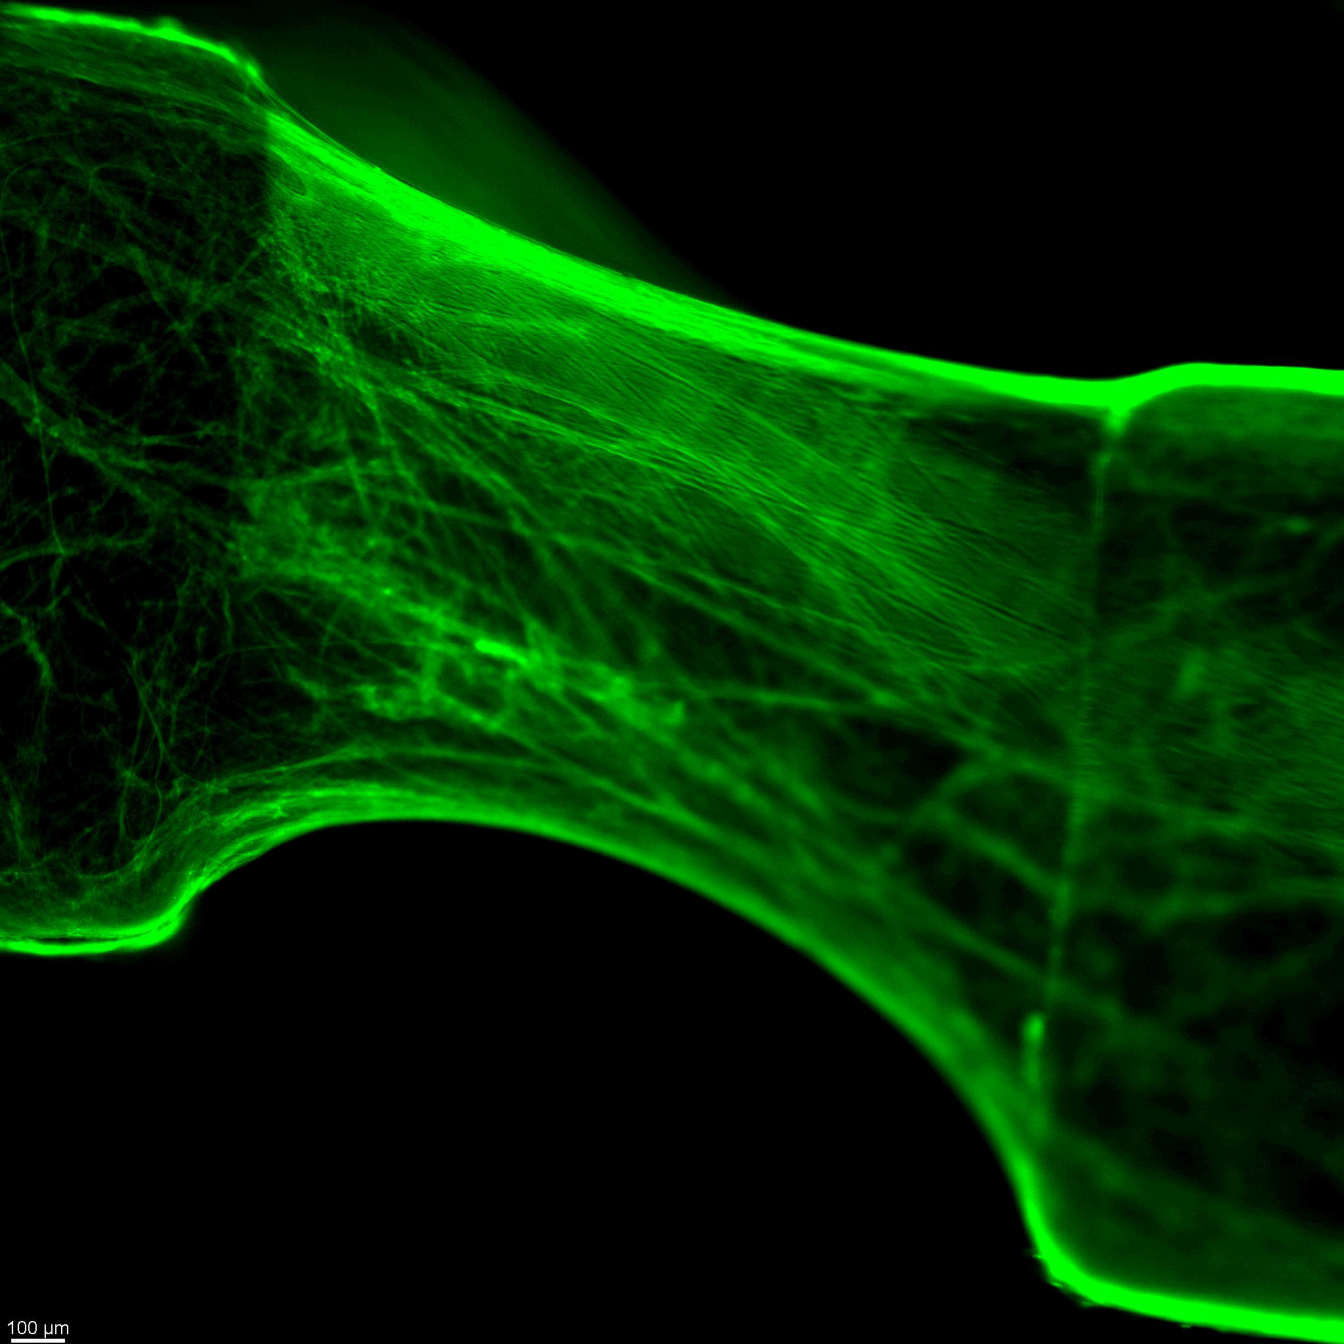
Future Work and Implications
These findings indicate material selection is critical when developing in vitro models of the pre-metastatic niche (PMN)
Future work:
Compare commercial FN to cancer cell-derived FN to determine the most physiologically relevant product for PMN
Apply these findings to our in vitro models
Newly developed 3D culture platform with FN network

Slide 6

Grant Acknowledgement
This project was funded with support from the Ralph W. and Grace M. Showalter Research Trust and METAvivor.

